Slide 1
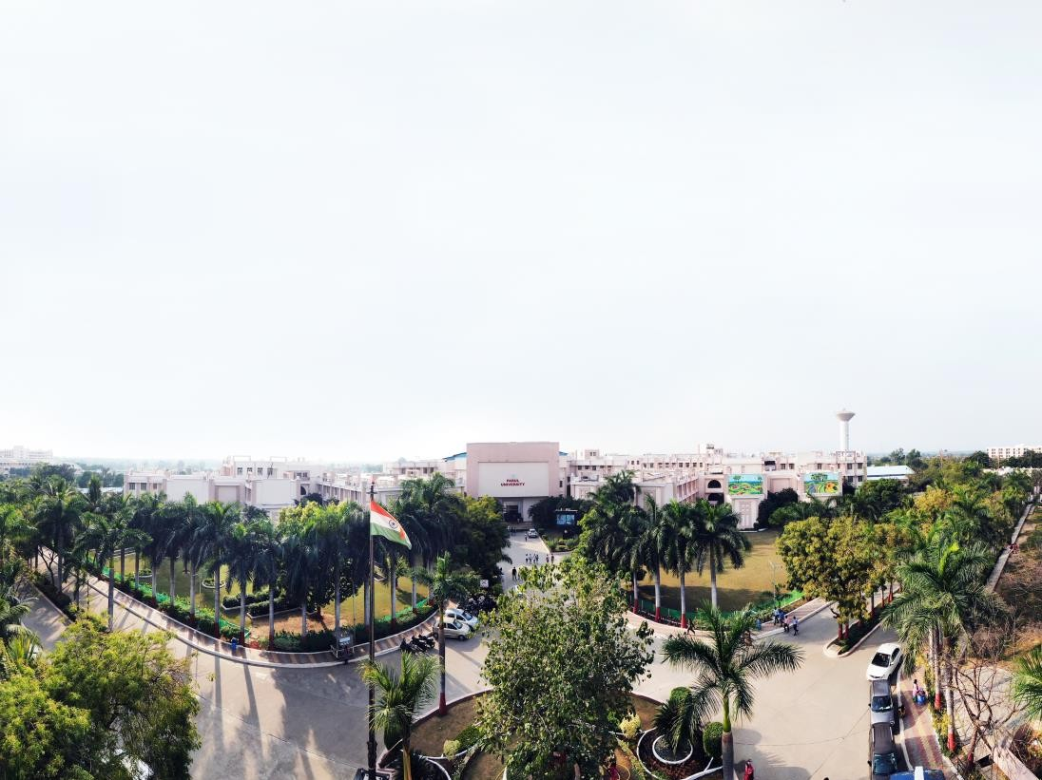


Unit 2
Android Components and Resource handling
Kunta Suthar, Assistant Professor
Computer Science and Engineering

Slide 2
Unit - 2
Android Components and Resource handling

Slide 3
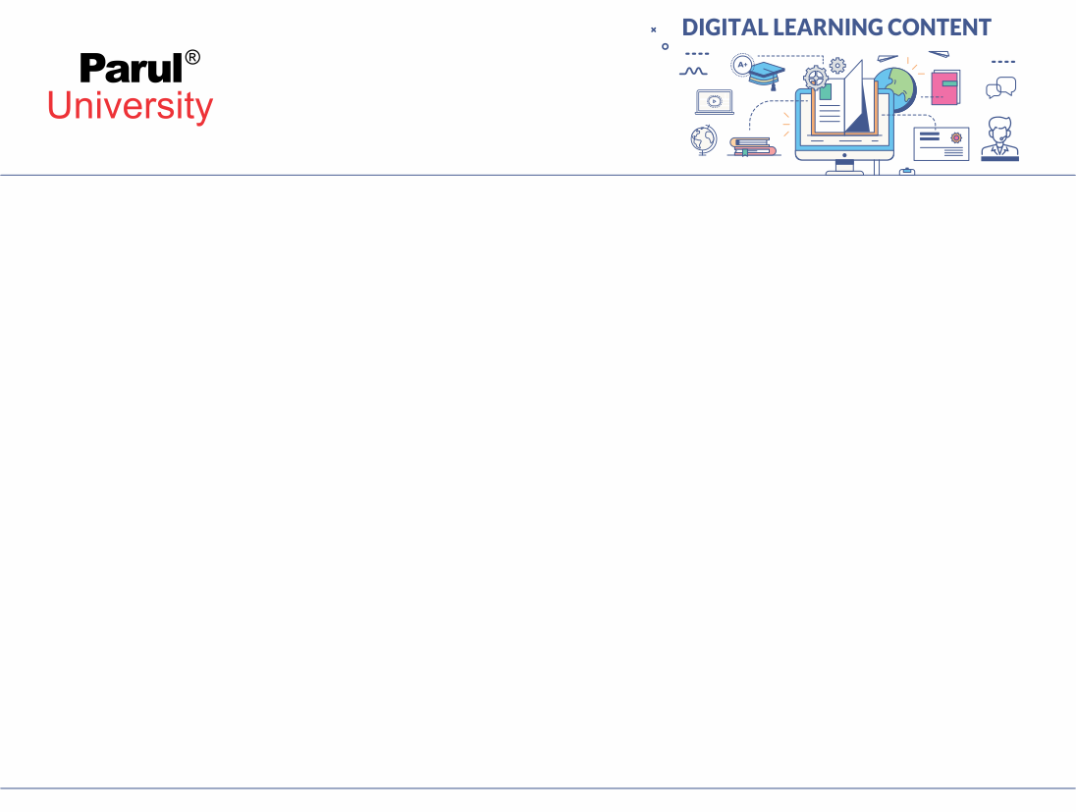

Android - Application Components
There are four types of app components:
Activities
Services
Broadcast receivers
Content providers

Slide 4
ACTIVITIES
Activities
An activity represents a single screen with a user interface,in-short Activity performs actions on the screen. For example, an email application might have one activity that shows a list of new emails, another activity to compose an email, and another activity for reading emails. If an application has more than one activity, then one of them should be marked as the activity that is presented when the application is launched.

Slide 5
Continue….
Services
A service is a component that runs in the background to perform long-running operations. For example, a service might play music in the background while the user is in a different application, or it might fetch data over the network without blocking user interaction with an activity.

Slide 6
Broadcast Receivers
Broadcast Receivers simply respond to broadcast messages from other applications or from the system. For example, applications can also initiate broadcasts to let other applications know that some data has been downloaded to the device and is available for them to use, so this is broadcast receiver who will intercept this communication and will initiate appropriate action.
A broadcast receiver is implemented as a subclass of BroadcastReceiver class and each message is broadcaster as an Intent object.

Slide 7
Content Providers
A content provider component supplies data from one application to others on request. Such requests are handled by the methods of the ContentResolver class. The data may be stored in the file system, the database or somewhere else entirely.
A content provider is implemented as a subclass of ContentProvider class and must implement a standard set of APIs that enable other applications to perform transactions.

Slide 8
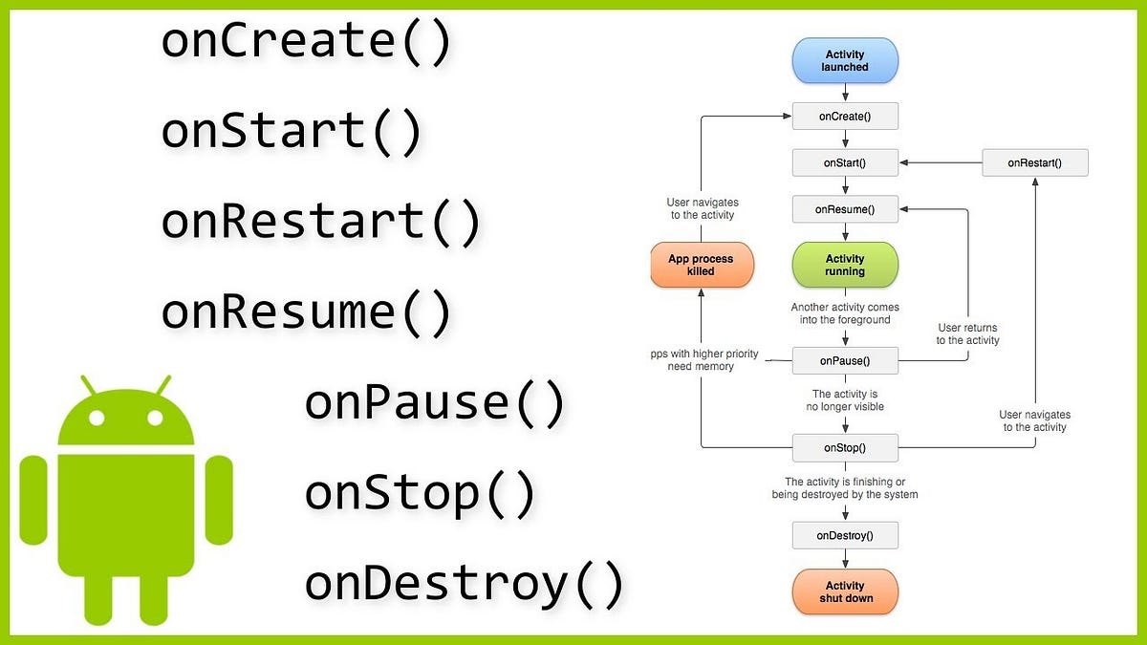

Activity Lifecycle in Android

Slide 9
1. OnCreate()
It is called when the activity is first created. This is where all the static work is done like creating views, binding data to lists, etc. This method also provides a Bundle containing its previous frozen state, if there was one.
@Override
protected void onCreate(Bundle savedInstanceState) {
super.onCreate(savedInstanceState);
setContentView(R.layout.activity_main);
}

Slide 10
Continue…..
onStart()
This callback is called when the activity becomes visible to the user.
onResume()
This is called when the user starts interacting with the application.
onPause()
The paused activity does not receive user input and cannot execute any code and called when the current activity is being paused and the previous activity is being resumed.
onStop()
This callback is called when the activity is no longer visible.
onDestroy()
This callback is called before the activity is destroyed by the system.
onRestart()
This callback is called when the activity restarts after stopping it.

Slide 11
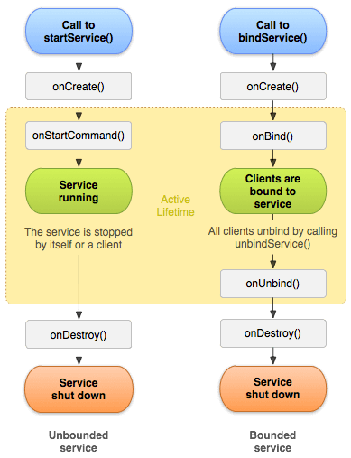
Life Cycle of Android Service

Slide 12
There can be two forms of a service.The lifecycle of service can follow two different paths: started or bound.
Started
Bound
1) Started Service
A service is started when component (like activity) calls startService() method, now it runs in the background indefinitely. It is stopped by stopService() method. The service can stop itself by calling the stopSelf() method.

Slide 13
Bound Service
A service is bound when another component (e.g. client) calls bindService() method. The client can unbind the service by calling the unbindService() method.
The service cannot be stopped until all clients unbind the service.

Slide 14
Broadcast receivers
Broadcast in android is the system-wide events that can occur when the device starts, when a message is received on the device or when incoming calls are received, or when a device goes to airplane mode, etc. Broadcast Receivers are used to respond to these system-wide events. Broadcast Receivers allow us to register for the system and application events, and when that event happens, then the register receivers get notified. There are mainly two types of Broadcast Receivers

Slide 15
Static Broadcast Receivers: These types of Receivers are declared in the manifest file and works even if the app is closed.
Dynamic Broadcast Receivers: These types of receivers work only if the app is active or minimized

Slide 16
Continue…
There are following two important steps to make BroadcastReceiver works for the system broadcasted intents −
Creating the Broadcast Receiver.
Registering Broadcast Receiver
Creating the Broadcast Receiver
A broadcast receiver is implemented as a subclass of BroadcastReceiver class and overriding the onReceive() method where each message is received as a Intent object parameter.

Slide 17
public class MyReceiver extends BroadcastReceiver { @Override public void onReceive(Context context, Intent intent) { Toast.makeText(context, "Intent Detected.", Toast.LENGTH_LONG).show(); } }

Slide 18
Registering Broadcast Receiver
An application listens for specific broadcast intents by registering a broadcast receiver in AndroidManifest.xml file. Consider we are going to register MyReceiver for system generated event ACTION_BOOT_COMPLETED which is fired by the system once the Android system has completed the boot process.

Slide 19
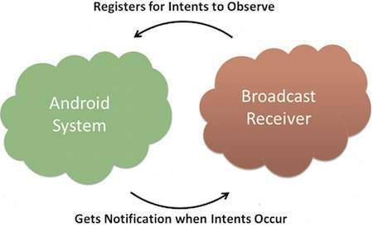

Slide 20
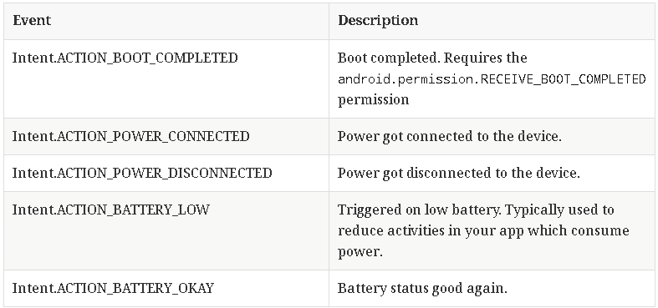
Event and Description

Slide 21
Content Providers
Content Providers in Android are a component of the Android operating system that enable applications to store and share data with other applications. A Content Provider provides an interface between an application and the Android data sources such as databases, files, and SharedPreferences. Content Providers are one of the four fundamental components of Android application development, along with activities, services, and broadcast receivers. Applications that need to access data from other applications use Content Providers.

Slide 22
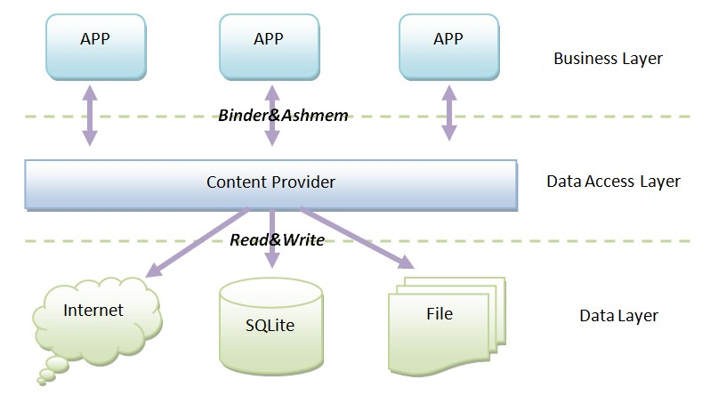

Slide 23
different parts of Content URI:
content:// – Mandatory part of the URI as it represents that the given URI is a Content URI.
authority – Signifies the name of the content provider like contacts, browser, etc. This part must be unique for every content provider.
optionalPath – Specifies the type of data provided by the content provider. It is essential as this part helps content providers to support different types of data that are not related to each other like audio and video files.
optionalID – It is a numeric value that is used when there is a need to access a particular record.

Slide 24
Operations in Content Provider
Four fundamental operations are possible in Content Provider namely Create , Read , Update , and Delete . These operations are often termed as CRUD operations .
Create: Operation to create data in a content provider.
Read: Used to fetch data from a content provider.
Update: To modify existing data.
Delete: To remove existing data from the storage.

Slide 25
Android Resource Types
In Android development, resources are elements such as images, strings, layouts,and other assets that are external to the application code. Resources are stored
in the res directory of an Android project and are essential for creating flexible
and maintainable applications that can adapt to different device configurations.
Android supports various types of resources, each serving a specific purpose.
1. Drawable Resources:
➢ Example: res/drawable/ic_launcher.xml
➢ Drawable resources are used for define various graphics with bitmaps or
XML,these can be PNG, JPEG, GIF, XML,SVG files or other drawable formats.
➢ Saved in res/drawable/ and accessed from the R.drawable class.

Slide 26
Continue..
2. Layout Resources:
➢ Example: res/layout/activity_main.xml
➢ Layout resources define the structure and appearance of user interfaces.
They use XML to specify the arrangement and properties of UI elements.
➢ Saved in res/layout/ and accessed from the R.layout class.
3. String Resources:
➢ Example: res/values/strings.xml
➢ String resources store text values, which allows for easy localization and
modification of text without changing the application code ,it Define
strings, string arrays, and plurals and include string formatting and styling.
➢ Saved in res/values/ and accessed from the R.string, R.array, and R.plurals
classes.

Slide 27
4. Color Resources:
➢ Example: res/values/colors.xml
➢ Color resources define color values that can be used throughout the
application, promoting consistent theming.
➢ XML resource that carries a hexadecimal color value, Saved in res/values/
and accessed from the R.color classes.
5. Style Resources:
➢ Example: res/values/styles.xml
➢ Style resources define sets of properties that can be applied to UI elements,
providing a consistent look and feel across the app,it define the look and
format for UI elements.
➢ Saved in res/values/ and accessed from the R.style class.

Slide 28
Dimen Resources:
➢ Example: res/values/dimens.xml
➢ Dimen resources store dimension values such as widths, heights, and
margins. This allows for easy adjustments and scaling across different
screen sizes and densities.
➢ Saved in res/values/ and accessed from the R.style class
Raw Resources:
➢ Example: res/raw/sample_data.json
➢ Raw resources store arbitrary files, such as JSON, XML, or media files, that
can be accessed directly through the R.raw class.
Menu Resources
➢ Define the contents of your application menus.
➢ Saved in res/menu/ and accessed from the R.menu class.

Slide 29
R.java
R.java
In Android development, the `R.java` file is an automatically generated resource
file that serves as a bridge between your source code and the resources (such as
layouts, drawables, strings, and IDs) that are part of your Android application. The
`R.java` file is generated by the Android build system during the compilation
process, and it contains unique identifiers for each resource defined in your
project.

Slide 30
What `R.java` does:
1. Resource IDs: The primary purpose of `R.java` is to assign unique integer
identifiers (IDs) to each resource you define in your project. For example, if you
have a layout file named `activity_main.xml` in the `res/layout` directory, the
`R.java` file will have a corresponding ID that you can use in your Java or Kotlin
code to reference that layout.
2. Package Structure: The `R.java` file is organized in a package structure that
mirrors the structure of your project's resources. For instance, if you have
drawable resources, string resources, and layout resources, you will find separate
inner classes within `R.java` for each resource type.
3. Auto-generated: You should never modify the `R.java` file manually because it
is automatically generated by the Android build tools. Any changes you make to

Slide 31
resources in your project will be reflected in the regenerated `R.java` file during
the next build.
4. Usage in Code: You reference resources in your code using the IDs generated in
`R.java`. For example, if you want to reference a string resource with the name
`app_name`, you can use `R.string.app_name` in your code. This ensures that
your code is dynamically linked to the resources at runtime.
How you might use `R.java` in an Android activity:
// Assuming you have a layout file named activity_main.xml
setContentView(R.layout.activity_main);
// Assuming you have a string resource named app_name
String appName = getString(R.string.app_name);

Slide 32
Android - Localization
The way of changing string into different languages is called as localization
Localizing Strings
In order to localize the strings used in your application , make a new folder under res with name of values-local where local would be the replaced with the region.
For example, in the case of italy, the values-it folder would be made under res. It is shown in the image below −

Slide 33
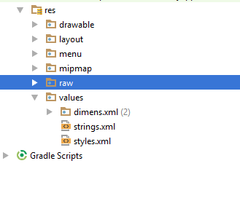

Slide 34
EXAMPLE
Once that folder is made, copy the strings.xmlfrom default folder to the folder you have created. And change its contents. For example, i have changed the value of hello_world string.
Italy, res/values-it/strings.xml
<;?xml version="1.0" encoding="utf-8"?> <resources> <string name="hello_world">Ciao mondo!</string> </resources>
Spanish, res/values-it/strings.xml
<;?xml version="1.0" encoding="utf-8"?> <resources> <string name="hello_world">Hola Mundo!</string> </resources>

Slide 35
French, res/values-it/strings.xml
<;?xml version="1.0" encoding="utf-8"?> <resources> <string name="hello_world">Bonjour le monde !</string> </resources

Slide 36
Continue..
Language & code
1 | Afrikanns Code: af. Folder name: values-af
2 | Arabic Code: ar. Folder name: values-ar
3 | Bengali Code: bn. Folder name: values-bn
4 | Czech Code: cs. Folder name: values-cs
5 | Chinese Code: zh. Folder name: values-zh
6 | German Code: de. Folder name: values-de
7 | French Code: fr. Folder name: values-fr
8 | Japanese Code: ja. Folder name: values-ja

Slide 37
www.paruluniversity.ac.in

